Slide 1
Analysis of H-1B visa data
Deep Arvind Bambharoliya Department of Applied Data Science
015935777 San Jose State University
Professor: Andrew H. Bond

Slide 2
Overview
H-1B visas are a category of employment-based, non-immigrant visas for temporary foreign workers in the United States.
For a foreign national to apply for H-1B visa, a US employer must offer them a job and submit a petition for a H-1B visa to the US immigration department.
This is also the most common visa status applied for and held by international students once they complete college or higher education and begin working in a full-time position.
This can include occupations in fields such as IT, finance, engineering, architecture or more.
According to USCIS, foreign workers with H-1B visas can stay in the US for up to six years, as an H-1B visa is initially valid for three years and can be extended for another three years.
The Office of Foreign Labor Certification (OFLC) generates program data, including data about H1-B visas. The disclosure data updated annually and is available online.
The dataset contains four years of H-1B petition records from 2018 to 2022 with approximately 2.5 million of records overall.(2,534,222)

Slide 3
About the Dataset
The dataset contains following fields
Case Number - Unique identifier assigned to each application submitted
Case Status - Status associated with the last significant event or decision. Valid values include “Certified”, “Certified-Withdrawn”, Denied”, and “Withdrawn”.
Case Submitted - Date the application was submitted
Visa Class - Indicates the type of temporary application submitted for processing. Values include H-1B, E-3 Australian, H-1B1 Chile, and H1B1 Singapore.
Employer Name - Legal business name of the employer submitting the Application
Employer Address - Employer street address
Employer City - Employer city name
Employer State - Employer state
Employer Postal Code - Employer postal code
Job Title - Title of the job

Slide 4
About the Dataset
SOC Code - Occupational code associated with the job as classified by the Standard Occupational Classification (SOC) System.
SOC Title - Occupational title associated with the SOC code
NAICS Code - Industry code associated with the employer, as classified by the North American Industrial Classification System (NAICS).
Full Time Position - Y = Full Time Position; N = Part Time Position.
Prevailing Wage - Prevailing Wage for the job being requested
PW Unit of Pay - Unit of Prevailing Wage Pay. Valid values include “Hour”, “Bi-weekly”, “Week”, “Month”, and “Year”.
PW Wage Level - OES Wage Level. Variables include "I", "II", "III", "IV" or "N/A
Wage Rate of Pay From -Wage paid to nonimmigrant worker
Wage Unit of Pay - Unit of Wage Pay. Valid values include “Hour”, “Bi-weekly”, “Week”, “Month”, and “Year”.
H1B Dependent - Y = Employer is H-1B Dependent; N = Employer is not H-1B Dependent.

Slide 5
Data Preparation
Data preparation has been done using the tableau prep builder.
Geographical role for employer city field has been changed to city.
Geographical role for employer state field has been changed to state/province.
Geographical role for employer postal code field has been changed to zipcode/postcode.
Converted wage and prevailing wage to uniform units(Year).
Removed outliers and set max wage to $1,000,000.
Performed cleaning and grouping operations on text data.
Created calculated fields as required for the analysis

Slide 6
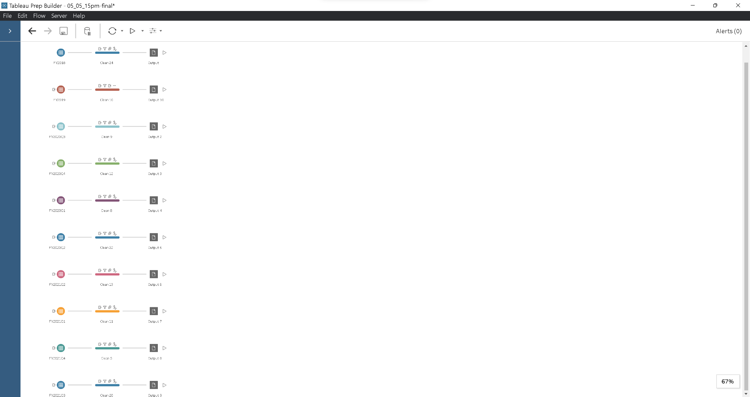
Data Preparation
Cleaned csv files using tableau prep builder and further cleaned and merged the files using python.

Slide 7
Visualizations Created for the project
Types of H-1B and filings in each years
Status of cases for each year
Total numbers of filing by each state
Number of filings by each industries
Top employers by number of petition
Wage distribution by state
Top job titles

Slide 8
Visualizations Created for the project
IX. Number of jobs for data scientist
X. Number of jobs for data analyst
XI. Salary comparison between DA and DS
XII. In-depth analysis of salary
XIII. DA and DS job distribution by State
XIV. Top cities for DA and DS
XV. Top companies for DA and DS

Slide 9

Visualizations on Tableau

Slide 10
References
https://www.dol.gov/agencies/eta/foreign-labor/performance
https://www.glassdoor.com/Salaries/us-data-analyst-salary-SRCH_IL.0,2_IN1_KO3,15.htm
https://www.glassdoor.com/Salaries/us-data-scientist-salary-SRCH_IL.0,2_IN1_KO3,17.htm
https://h1bdata.info/index.php?em=&job=data+analyst&city=&year=All+Years
https://h1bdata.info/index.php?em=&job=Data+Scientist&city=&year=All+Years

